Slide 1
Brain Rot Translator user profile
- Aarav

Slide 2
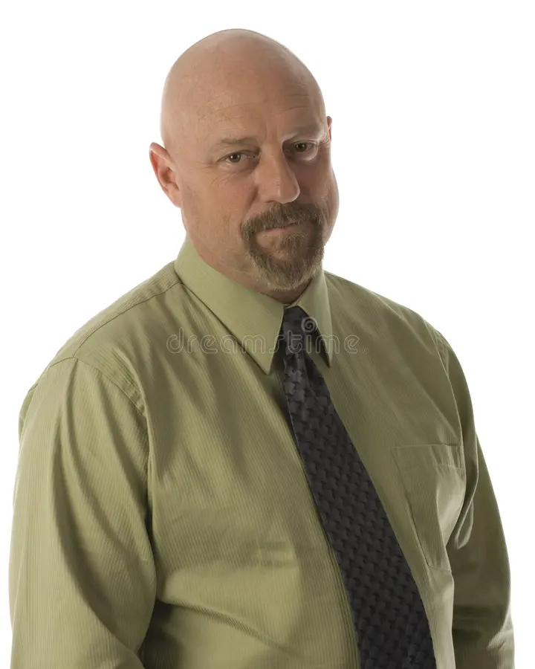
👤 User Profile
Name: Sarah Johnson
Age: 42
Profession: Middle school teacher and parent of two kids

Slide 3
Story
Story:
Jack is a busy teacher and parent who spends a lot of time balancing work and family. He uses the internet every day, mostly on his phone and laptop, but he doesnt scroll endlessly on TikTok or Twitter. His kids and students often bring up new memes, slang, or funny videos, and he doesnt always understand them. He doesnt want to feel left out, so hes looking for a simple, safe, and fun way to catch up on whats trending without diving into overwhelming social media feeds.
What he Likes:
Weekly updates that explain internet trends in plain, simple language
A playful but clean design that feels fun but not messy
Short blurbs with pictures she can skim quickly
Family-friendly content she can even share with his kids
A chance to vote on her favorite trend for a sense of participation
An optional weekly email reminder so he doesnt forget to check

Slide 4
https://forms.gle/cadiGuC3x3krFYc87

